Slide 1
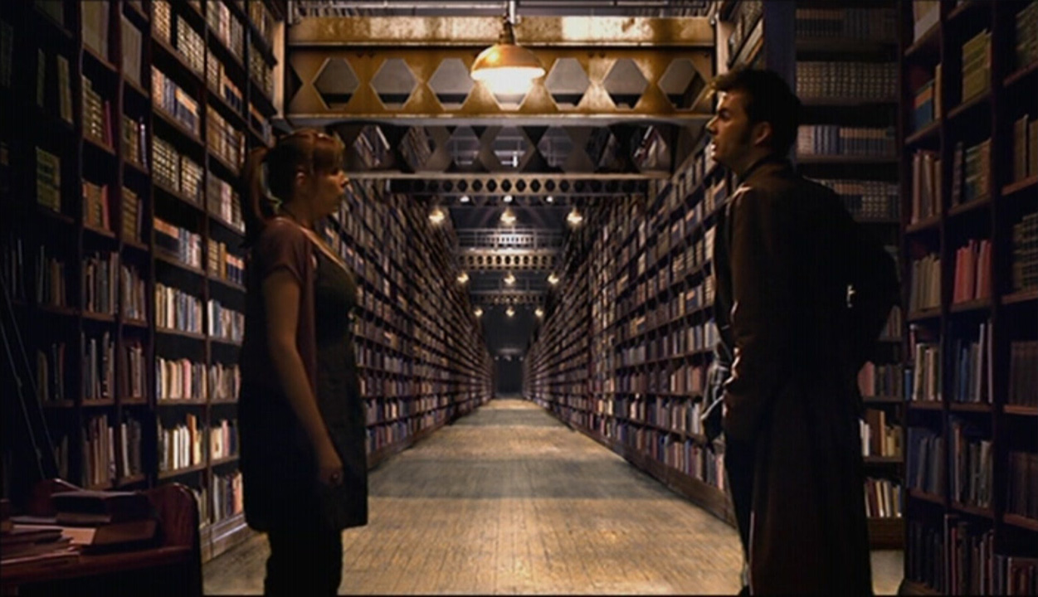

Silence in the Library: from Copyright Collections to Cage

Slide 2
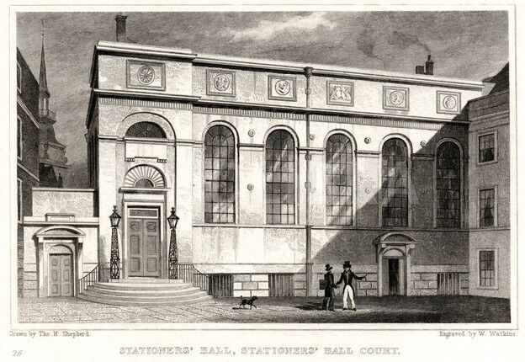
Legal deposit – Copyright’s Shadowy Cousin

Slide 3

Researcher - Librarian

Slide 4
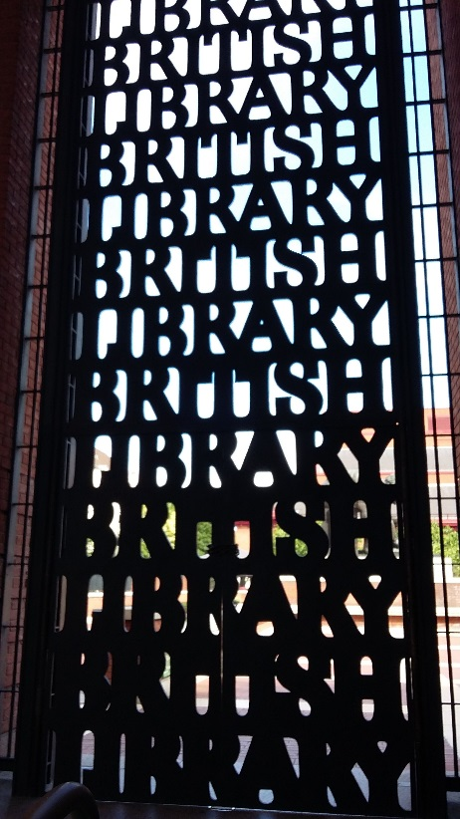
British Library at St Pancras

Slide 5
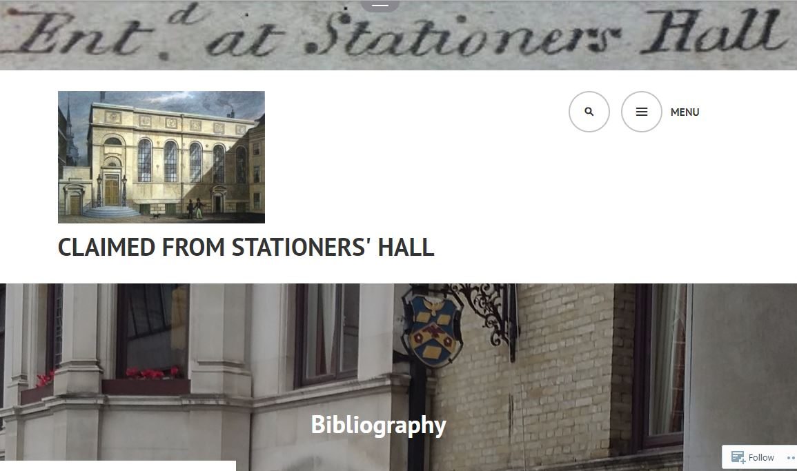
https://claimedfromstationershall.wordpress.com/bibliography/
CFSH Network -
Bibliography includes articles about Georgian/Victorian music case law.

Slide 6
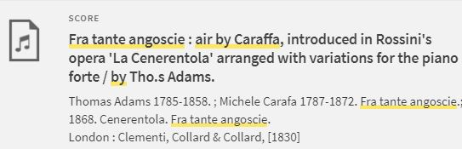
Whose creative effort?!
Cambridge University Library catalogue entry

Slide 7
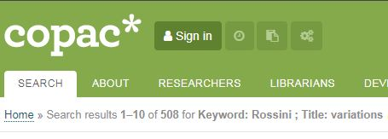
Rossini: prolific and popular

Slide 8

PG Certificate in Learning & Teaching

Slide 9
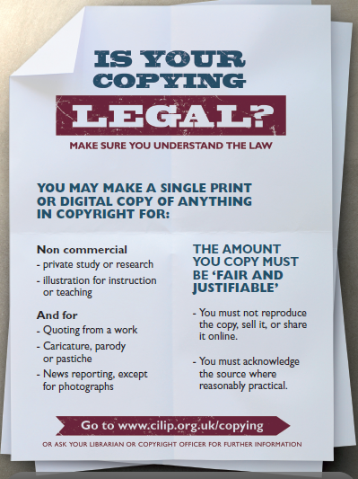
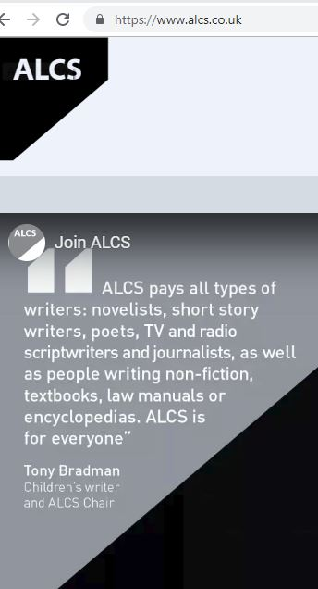
Essential Knowledge …

Slide 10
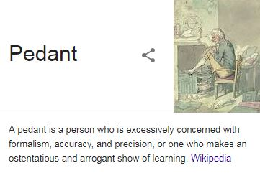
Pedantic, Fussy, Rule-Bound?

Slide 11
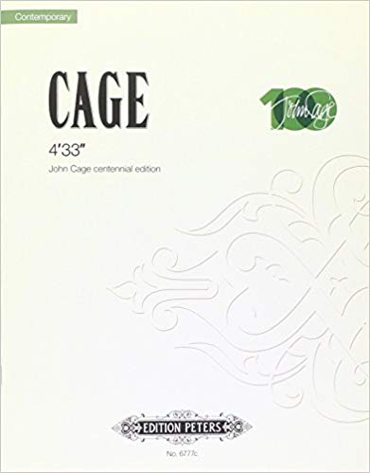
John Cage’s 4’33”

Slide 12

Contemporary Performance Practice

Slide 13
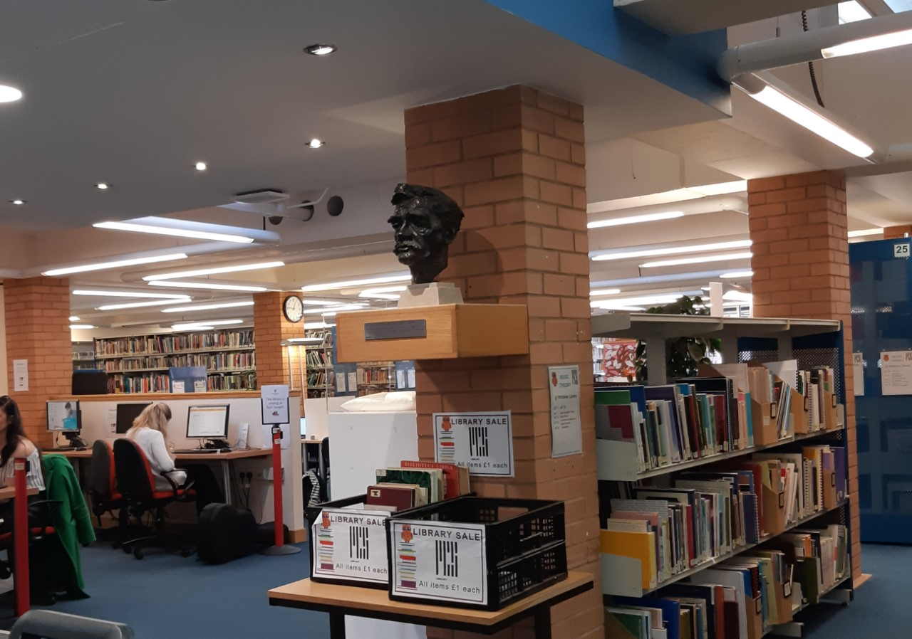
RCS - busy, working Conservatoire Library

Slide 14

Any instrument or combination …

Slide 15
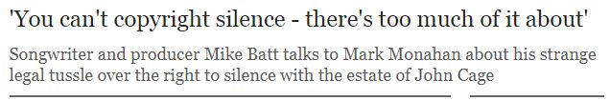
The man who composed The Wombles!

Slide 16
Seymour, David M. (2013)
‘This is the piece that everyone here has come to experience’: the challenges to copyright of John Cage’s 4’33”, in Legal Studies 33.4, pp.532-548
Seymour quotes Cheng Saw:- Originality
Protectable expression
Uncertainty of subject matter

Slide 17
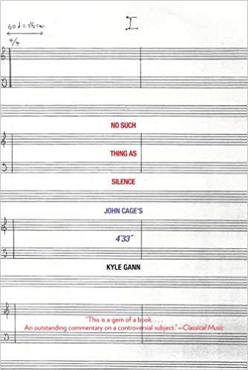
“No such thing as silence”
The Score with Lines and Spaces …
… but no Notes

Slide 18
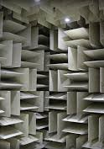
TOTAL Silence?
An Anechoic Chamber

Slide 19
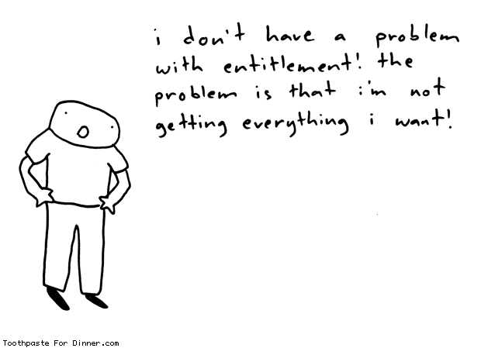
“It’s okay for me to copy …”

Slide 20
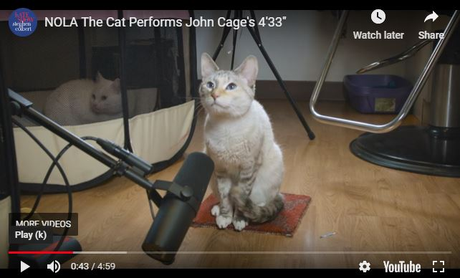
But is it music? Is it original?

